Slide 1
AA/B3/8조
HolubSQL Practice2

Slide 2
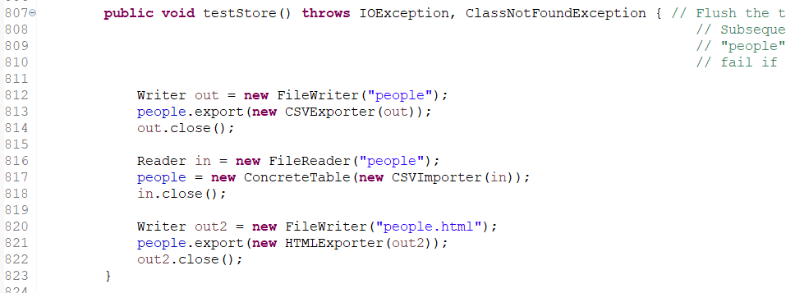
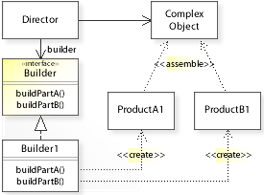
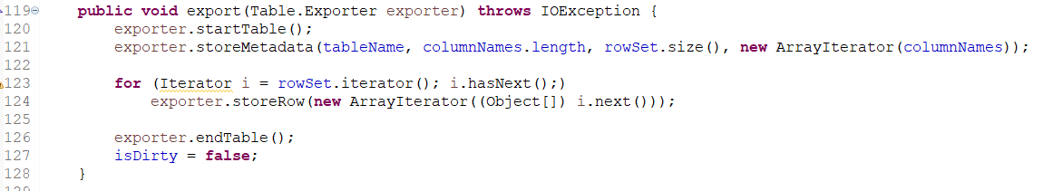
Client
ConcreteTable
Table HTML code
Exporter
thead HTML
tbody HTML
Director (ConcreteTable)
HTMLExporter

Slide 3
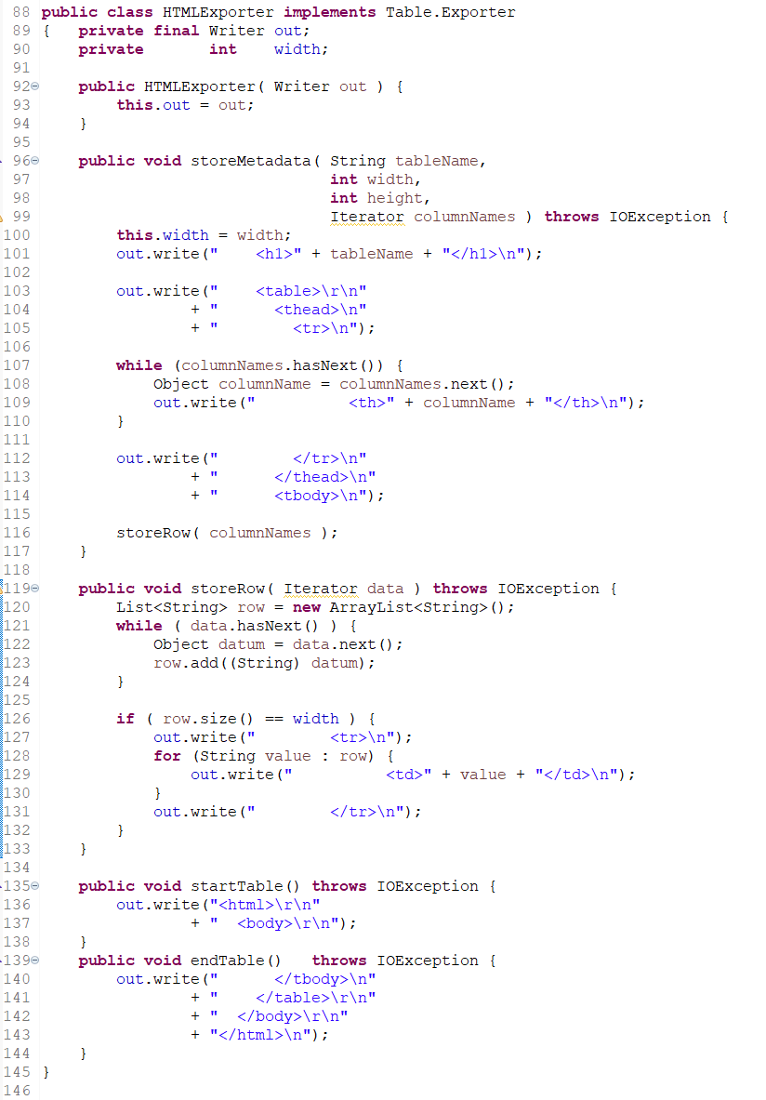
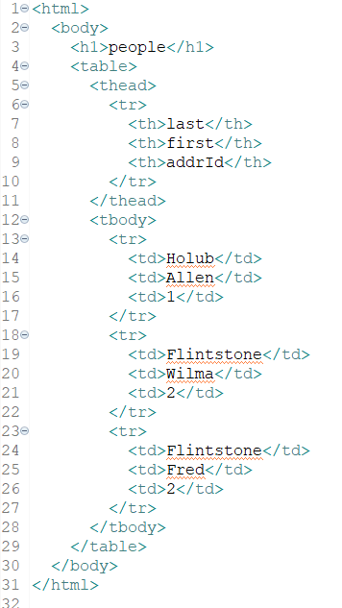
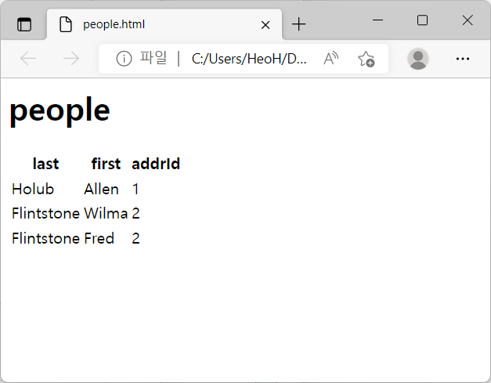
Builder (HTMLExporter)
Output

